Slide 1
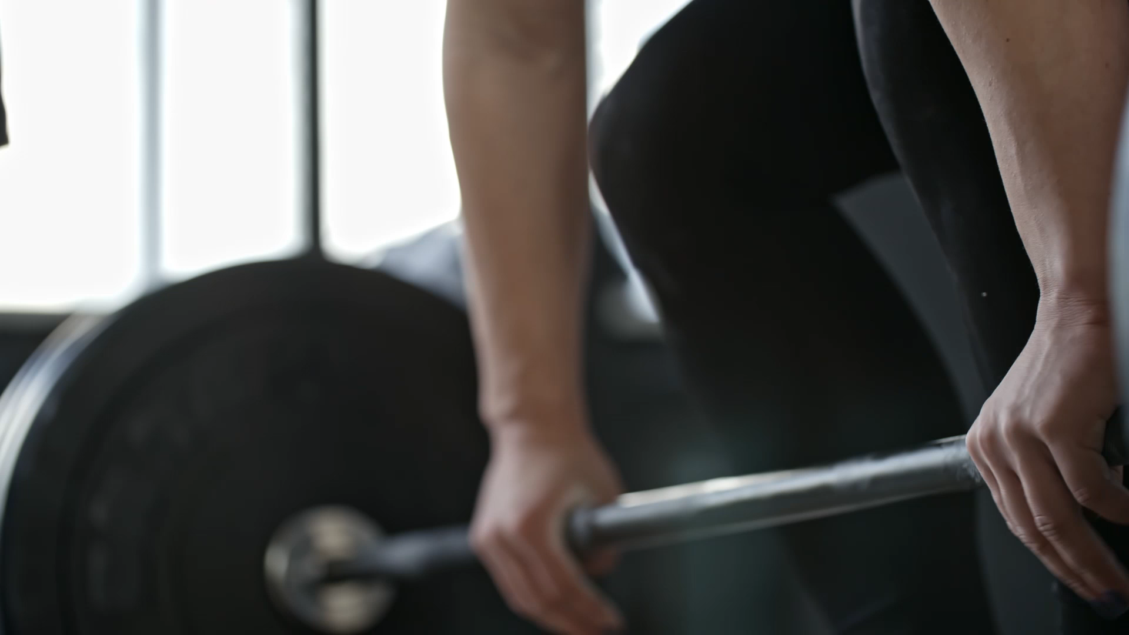
FITNESS UNIT
PHYSICAL EDUCATION

Slide 2

FITNESS -THE CONDITION OF BEING PHYSICALLY FIT AND HEALTHY.

Slide 3

MAJOR FITNESS COMPONENTS (5)
CARDIOVASCULAR
FLEXIBILITY
BODY COMPOSITION
MUSCULAR STRENGTH
MUSCULAR ENDURANCE

Slide 4

CARDIOVASCULAR
Cardiovascular means related to your heart and blood vessels, like the pipes that carry blood all around your body. It's about how your heart pumps blood to give your muscles and organs the oxygen and nutrients they need to work properly."

Slide 5


FLEXIBILITY
The range of motion in your joints and muscle. Flexibility means how easily your body can bend, stretch, and move its different parts. Being flexible helps you touch your toes, and move your body comfortably without feeling stiff.

Slide 6

BODY COMPOSITON
Body composition is about understanding what your body is made of, like muscles, bones, and fat. It helps you see how healthy and strong you are and how your body's different parts fit together.

Slide 7

MUSCULAR STRENGTH
Muscular strength is how strong your muscles are. It's like how much you can lift or push. When you have good muscular strength, you can do things that need power, like lifting heavy things or doing push-ups."

Slide 8

MUSCULAR ENDURANCE
Muscular endurance is how long your muscles can keep working without getting tired. It's like how many times you can do an exercise, like sit-ups or squats, without your muscles feeling too worn out.

Slide 9
COMPREHENSION QUIZ
1) What your body is made of, like muscles, bones, and fat.
A) CARDIOVASCULAR
B) FLEXIBILITY
C) BODY COMPOSITION
D) MUSCULAR STRENGTH
E) MUSCULAR ENDURANCE
2) How strong your heart and lungs are.
A) CARDIOVASCULAR ENDURANCE
B) FLEXIBILITY
C) BODY COMPOSITION
D) MUSCULAR STRENGTH
E) MUSCULAR ENDURANCE

Slide 10

COMPREHENSION QUIZ
3) How long your muscles can keep working without getting tired.
A) CARDIOVASCULAR
B) FLEXIBILITY
C) BODY COMPOSITION
D) MUSCULAR STRENGTH
E) MUSCULAR ENDURANCE
4) The range of motion in your joints and muscle.
A) CARDIOVASCULAR
B) FLEXIBILITY
C) BODY COMPOSITION
D) MUSCULAR STRENGTH
E) MUSCULAR ENDURANCE

Slide 11
COMPREHENSION QUIZ
5) How strong your muscles are. How much you can lift or push.
A) CARDIOVASCULAR
B) FLEXIBILITY
C) BODY COMPOSITION
D) MUSCULAR STRENGTH
E) MUSCULAR ENDURANCE

Slide 12

FITNESSGRAM TEST VISUALS

Slide 13
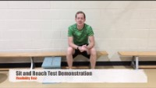

Slide 14
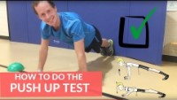

Slide 15


Slide 16
DOES EVERYONE UNDERSTAND HOW TO COMPLETE THE FITNESSGRAM TASK(S)?
SIT AND REACH, PUSH-UP, AND CURL UP ASSESSMENT

